Slide 1
Face Mask Detection a classification problem with 3 classes
Peter Ivanov
LÁSZLÓ MOCSÁRY
GDA track 3B – 12/17/2021

Slide 2
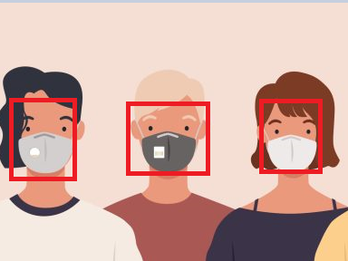
INTRODUCTION
The final objective is to classify an image into the three classes
correct use of mask,
incorrect use of mask,
no mask at all

Slide 3
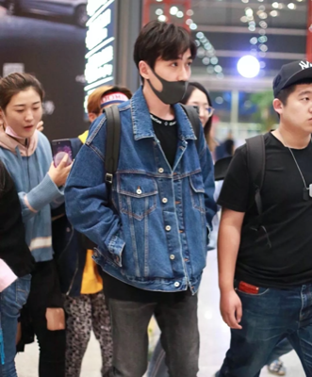
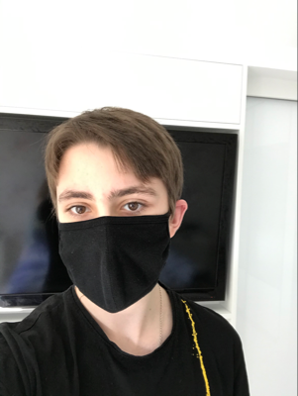
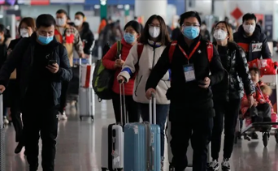
Primary Image Data
Data is available at the Kaggle site
853 RGB primary images of people
one or more persons in each
4072 faces annotated in total
faces in various positions
in different sizes

Slide 4
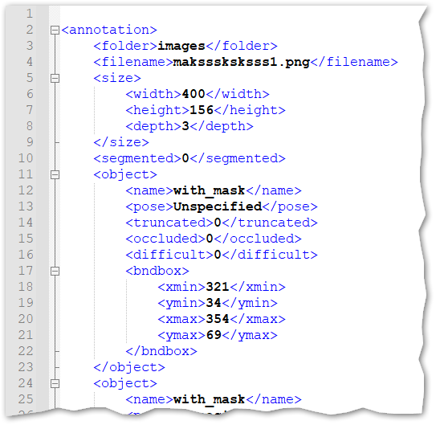
Primary Image Annotations
853 annotations files
XML format
Relevant content:
Filenames
Labels (tag: name)
Bounding box coords (tag: bndbox)

Slide 5
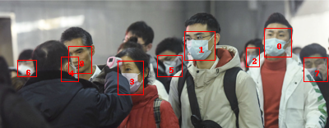
Primary Image Annotations
Box[0] = [321, 34, 354, 69]
Box[1] = [224, 38, 261, 73]
Box[2] = [299, 58, 315, 81]
Box[3] = [143, 74, 174, 115]
Box[4] = [74, 69, 95, 99]
Box[5] = [191, 67, 221, 93]
Box[6] = [21, 73, 44, 93]
Box[7] = [369, 70, 398, 99]
Box[8] = [83, 56, 111, 89]
Target[0] = with_mask
Target[1] = with_mask
Target[2] = with_mask
Target[3] = with_mask
Target[4] = with_mask
Target[5] = with_mask
Target[6] = with_mask
Target[7] = with_mask
Target[8] = without_mask

Slide 6
Data exploration

Slide 7
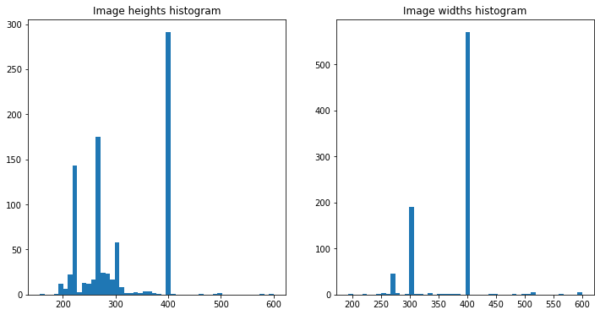
Primary images size distribution
Sizes of the primary images are various.
This does not matter as we’ll be working with face images cut out of these primary ones.

Slide 8
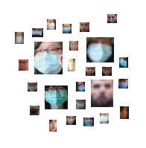
Face images extraction
4072 face images have been cut out of the 853 primary images

Slide 9
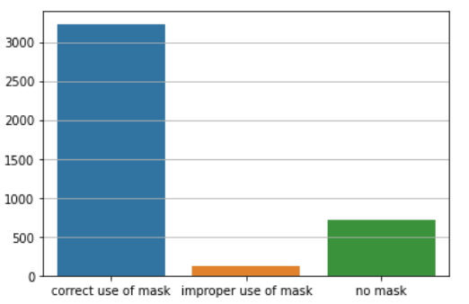
Class distribution of data - imbalanced
Class distribution of face images is strongly imbalanced.
Out of 4072 face images:
3232 – properly worn mask
123 – improperly worn mask
717 – no mask

Slide 10
Data preprocessing

Slide 11
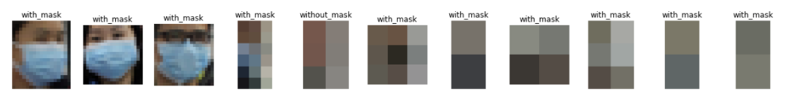
Data selection
Face images differ in size in a range from 1x2 to 317 x 337 pixels.
Based on the area (h x w) we dropped away all face images with area less than a defined threshold (i.e. pixels)

Slide 12
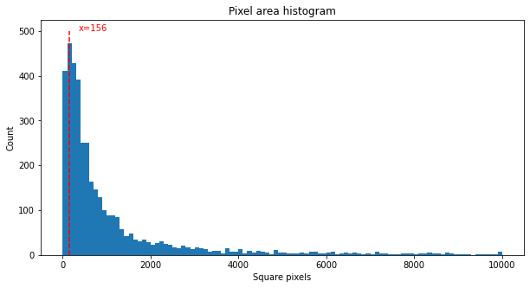
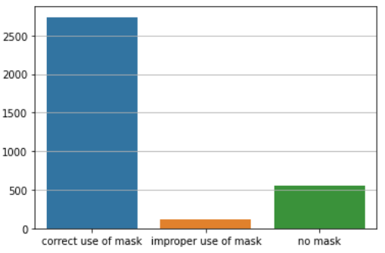
Face images size distribution
We decided to cut off very tiny images with pixel area lower than 156 pixels.
In total 665 face images were removed.
492 from class correct_use_of_mask'
162 from class 'no_mask'
11 from class 'improper_use of_mask'
Data distribution among the 3 classes got slightly better but it is still imbalanced

Slide 13
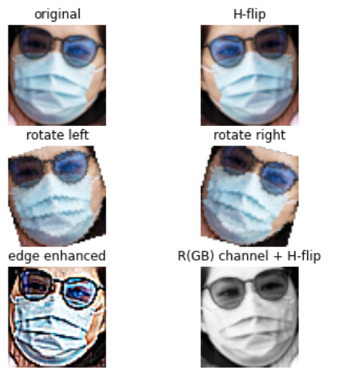
Train-test split with data augmentation
The remaining face images have been split among the test set (20%) and the training set (80%)
The training set images have been 5-fold augmented.
The total size of the training set is 16350 images.

Slide 14
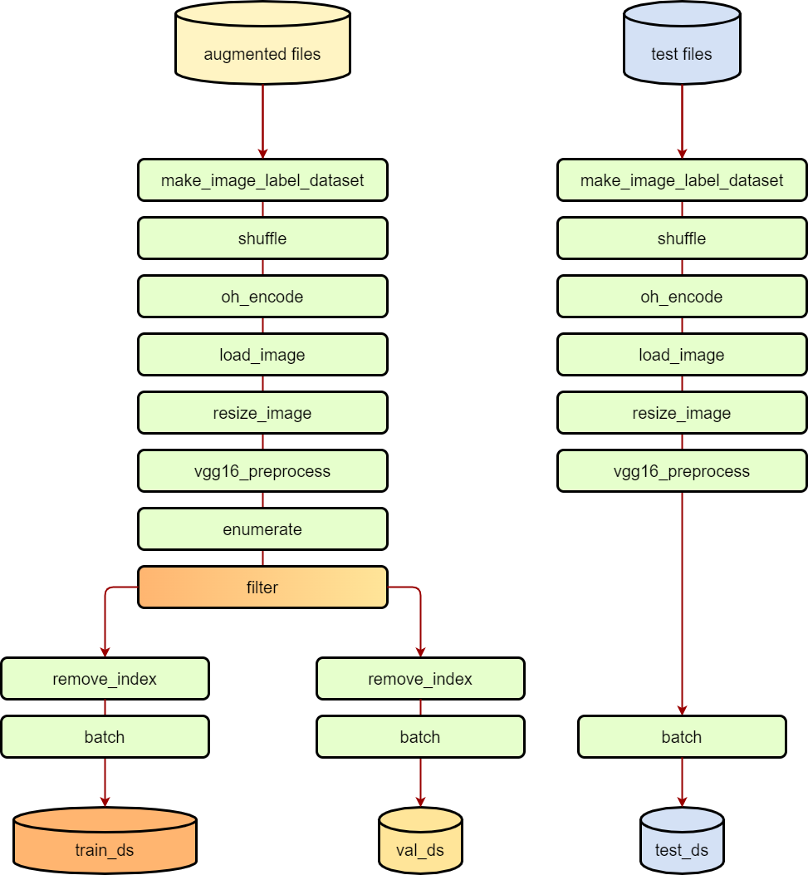
Tensorflow pipelines
Three Tensorflow datasets were created for the training, validation and evaluation of the CNN model.
Notable parts:
Input from two different folders on filesystem
vgg16_preprocess step as requirement for the model
enumerate-filter-remove_index chain to do train / validation split

Slide 15
CNN Model

Slide 16
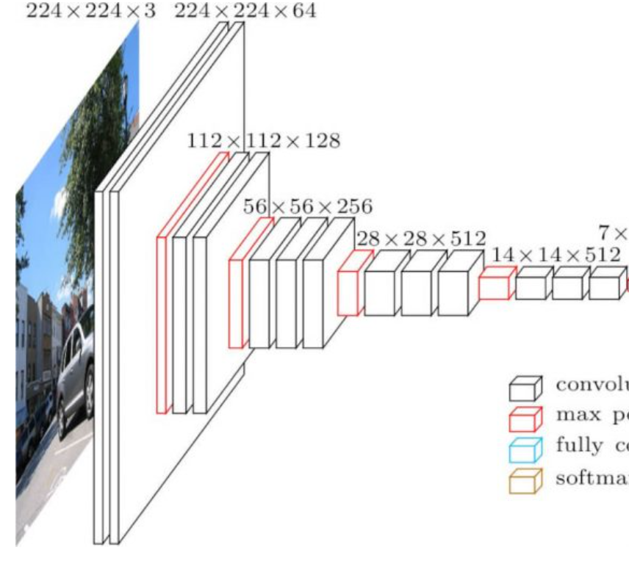
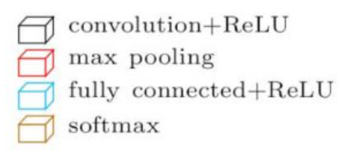
Setup the model
The model base is the pretrained VGG16 CNN with the 'ImageNet' weights and all its layers but the densely connected classifier on top of the network.
All the layers of the VGG16 are set to 'untrainable'.
On top of that we add a max_pooling layer, a flattening layer, a dense layer and an output (dense) layer with 3 node and 'softmax' activation.

Slide 17
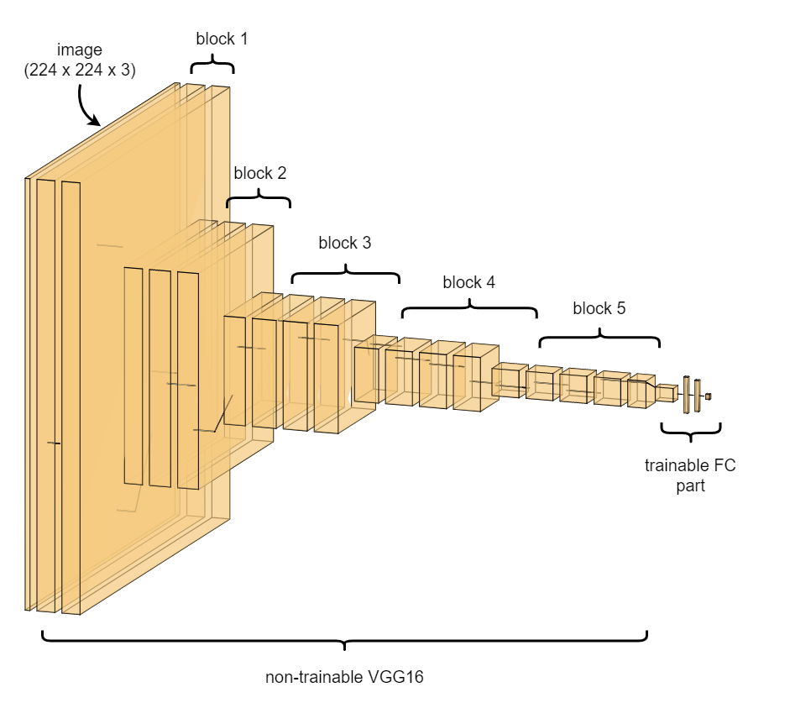
Model setup
The model base is the pretrained VGG16 CNN with the 'ImageNet' weights and all its layers but the densely connected classifier on top of the network.
All the layers of the VGG16 are set to 'untrainable'.
On top of that we add a max_pooling layer, a flattening layer, a dense layer and an output (dense) layer with 3 node and 'softmax' activation.

Slide 18

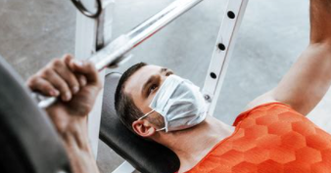
Compile and fit the model
The model was compiled with following parameters:
Optimizer: ADAM
Learning rate: 0.001
Loss function: categorical_crossentropy
Metrics: CategoricalAccuracy, Precision, AUC
… and fitted with:
Epochs: 10
Batch size: 8 – set in the tf.pipeline
Steps_per_epoch: 1635 (num of train_data / batch_size)
Validation_data: val_ds (also batched)

Slide 19
Classification Results

Slide 20
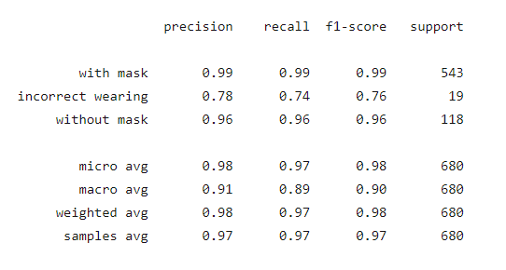
Simple cutoff (0.5)
This simple cutoff was applied to the test set predictions.
I.e. if prediction for the particular class is > 0.5 then the class is predicted as 1
Per-class accuracy:
Accuracy [with mask] = 98.09%
Accuracy [incorrect wearing] = 98.68%
Accuracy [without mask] = 98.53%

Slide 21
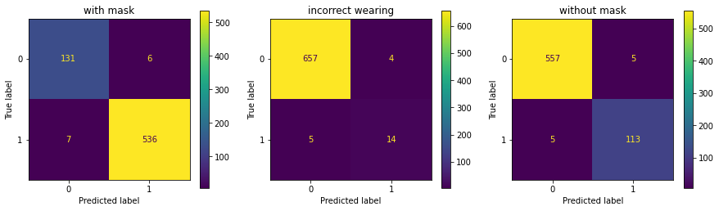
Confusion matrices (cutoff = 0.5)

Slide 22
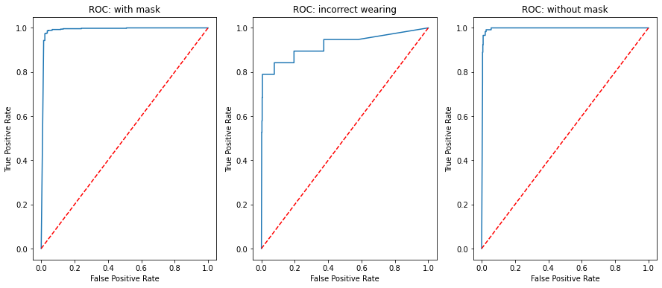
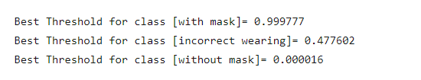
Optimized cutoffs
Optimized cutoffs were calculated using ROC curve:
True positive rate was maximized.
False positive rate was minimized.

Slide 23
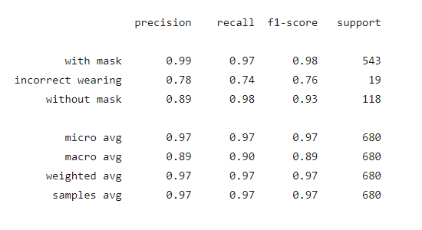
Optimized cutoffs
Optimized cutoffs were calculated using ROC curve:
True positive rate was maximized.
False positive rate was minimized.
Per-class accuracy:
Accuracy [with mask] = 97.35%
Accuracy [incorrect wearing] = 98.68%
Accuracy [without mask] = 97.50%

Slide 24
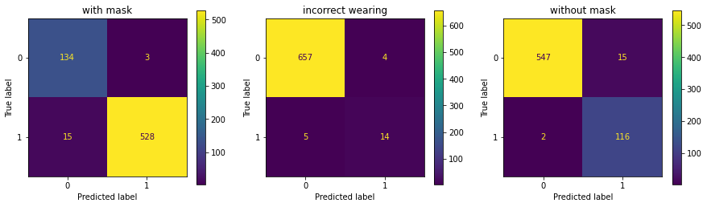
Confusion matrices (optimized cutoff)

Slide 25
Comparison

Slide 26
Wild Data

Slide 27
Face detection
We integrated Multi-task Cascaded Convolutional Network (MTCCN) to help us to work with data that wasn’t annotated.
This enabled us to detect faces in the images.
This way we were able to test the model on the real-world data.

Slide 28
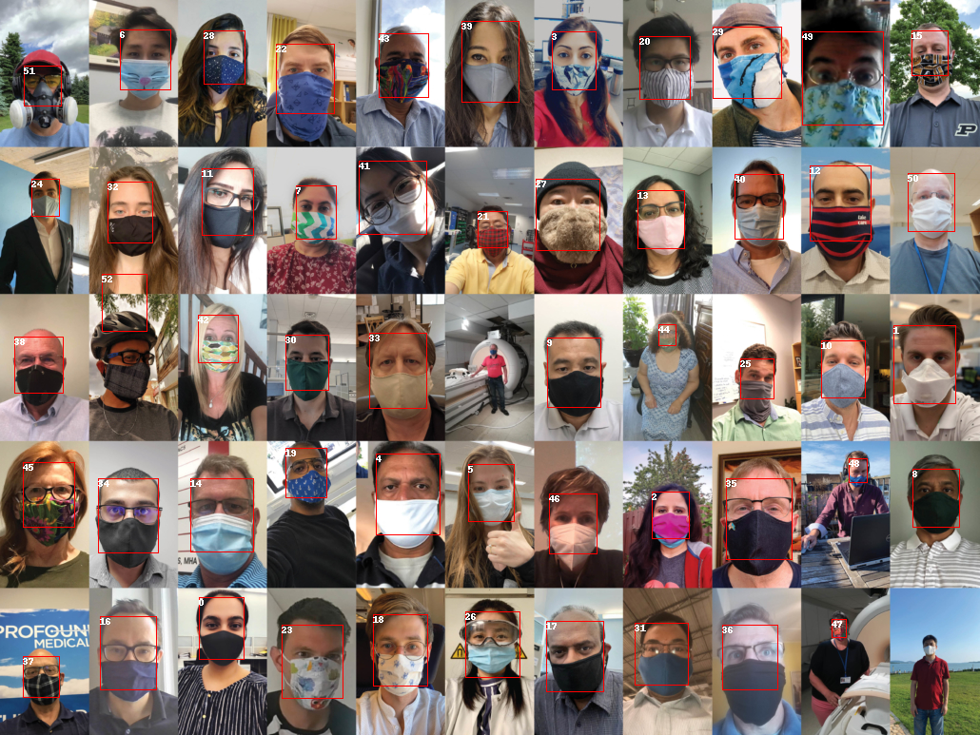
mosaic.jpg
Face 27: with mask
Face 28: with mask
Face 29: with mask
Face 30: with mask
Face 31: with mask
Face 32: with mask
Face 33: with mask
Face 34: with mask
Face 35: with mask
Face 36: with mask
Face 37: with mask
Face 38: with mask
Face 39: incorrect wearing
Face 40: with mask
Face 41: with mask
Face 42: with mask
Face 43: with mask
Face 44: with mask
Face 45: incorrect wearing
Face 46: with mask
Face 47: without mask
Face 48: incorrect wearing
Face 49: with mask
Face 50: with mask
Face 51: with mask
Face 52: with mask
Found 53 face(s) in mosaic.jpg.
Face 0: with mask
Face 1: with mask
Face 2: with mask
Face 3: with mask
Face 4: incorrect wearing
Face 5: with mask
Face 6: with mask
Face 7: with mask
Face 8: with mask
Face 9: with mask
Face 10: with mask
Face 11: with mask
Face 12: with mask
Face 13: with mask
Face 14: with mask
Face 15: with mask
Face 16: with mask
Face 17: incorrect wearing
Face 18: with mask
Face 19: with mask
Face 20: with mask
Face 21: with mask
Face 22: with mask
Face 23: with mask
Face 24: with mask
Face 25: with mask
Face 26: with mask

Slide 29
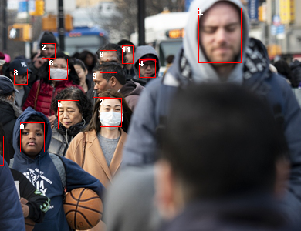
street.jpeg
Found 14 face(s) in street.jpeg.
Face 0: without mask
Face 1: without mask
Face 2: without mask
Face 3: without mask
Face 4: without mask
Face 5: without mask
Face 6: with mask
Face 7: with mask
Face 8: without mask
Face 9: with mask
Face 10: without mask
Face 11: without mask
Face 12: with mask
Face 13: with mask

Slide 30
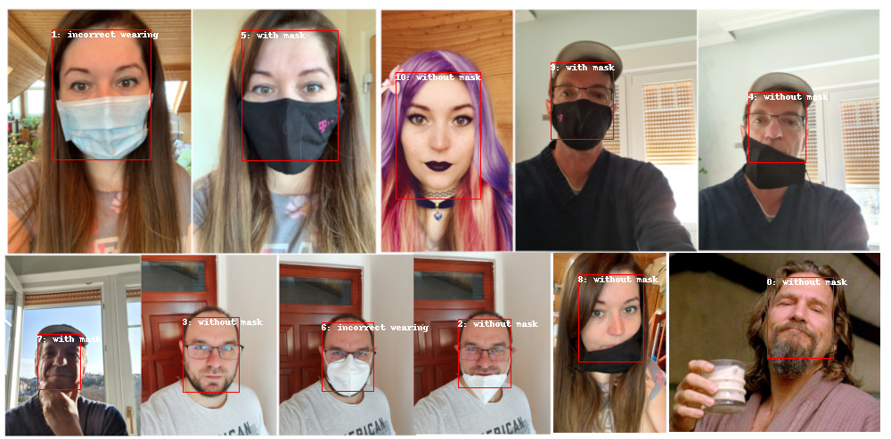
mosaic2.jpg
Found 11 face(s) in mosaic2.jpg.
Face 0: without mask
Face 1: incorrect wearing
Face 2: without mask
Face 3: without mask
Face 4: without mask
Face 5: with mask
Face 6: incorrect wearing
Face 7: with mask
Face 8: without mask
Face 9: with mask
Face 10: without mask

Slide 31
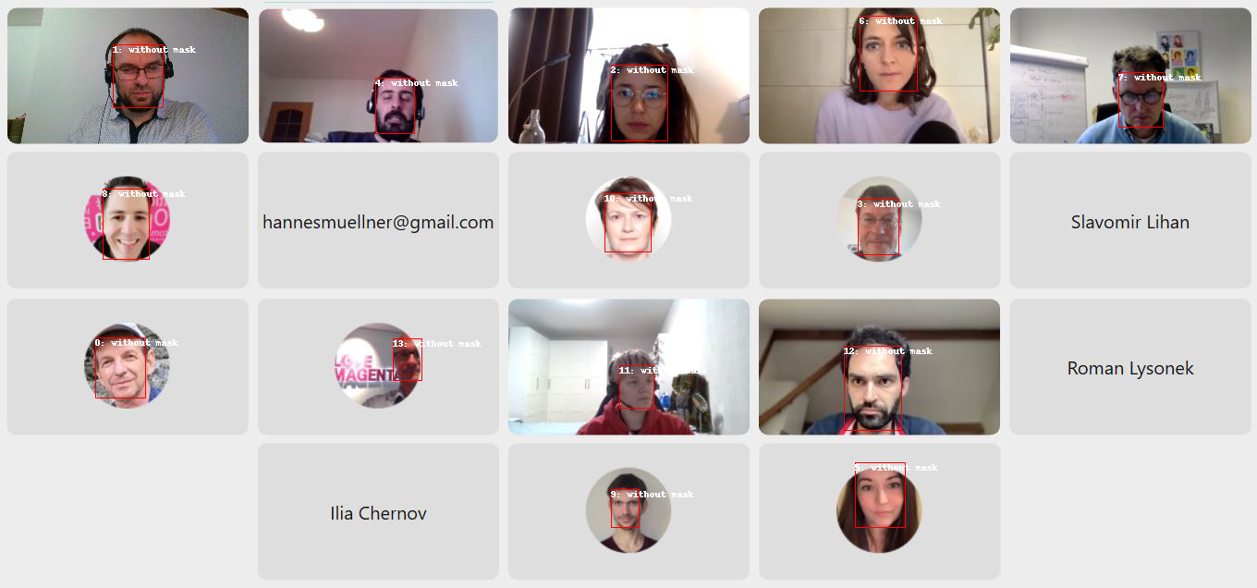
Webex.jpg
Found 14 face(s) in Webex.jpg.
Face 0: without mask
Face 1: without mask
Face 2: without mask
Face 3: without mask
Face 4: without mask
Face 5: without mask
Face 6: without mask
Face 7: without mask
Face 8: without mask
Face 9: without mask
Face 10: without mask
Face 11: without mask
Face 12: without mask
Face 13: without mask

Slide 32
Project status
Achievements:
A running model that was trained with the data provided
The model is able to predict the test data with a high accuracy
The model is able to make predictions of any unseen data but with a significantly worse accuracy
Possible causes:
Data set imbalance and the huge number of "small" images
the model overfits to the data we got
the (test) data had very little variance, which "helped" to not notice the overfitting in the first-shown metrics

Slide 33
Improvement ideas
Perform better real-world model evaluation to get actual performance metrics
Acquire more real-world images to increase variance in the train data
Improve the class balance
Do extensive hyperparameter tuning on the FC part of the model
Try out other pre-trained models

Slide 34
Discussion - Q&R

